Slide 1


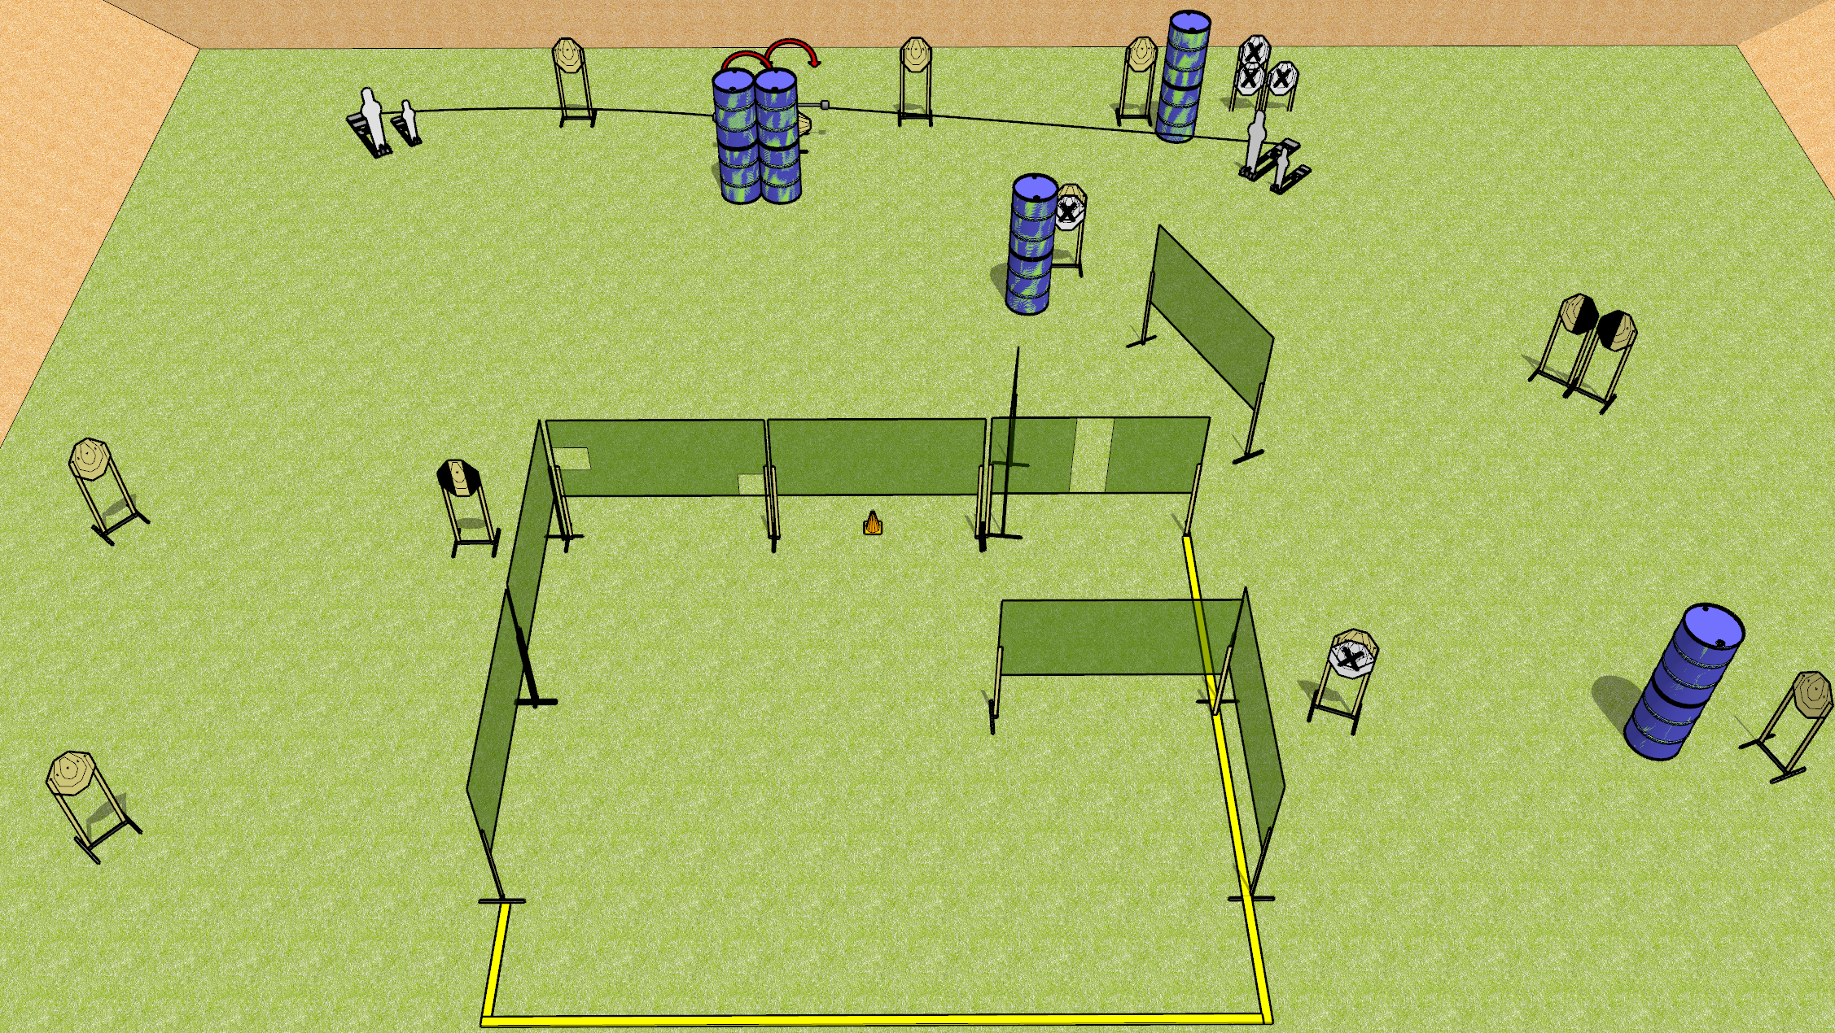
 | Dothan Gun Club – USPSA Match Swinging Together Course Designer : Drew Coleman
START POSITION : Standing anywhere along rear fault line outside the shooting area, toes touching rear fault line. Wrists below belt
GUN READY CONDITION : Pistol loaded and holstered. PCC loaded, shouldered, safety on, pointed at orange cone. |  | SCORING: Comstock, 30 rounds TARGETS: 13 paper, 4 Steel SCORED HITS: Best 2 on paper, steel until down START-STOP: Audible, last shot RULES:
STAGE PROCEDURE: Engage targets as they become available from within the fault lines.

